Slide 1







SURRENDERED

Slide 2




Mga dahilan kung bakit kailangan natin ipagkatiwala ang buhay natin sa DIYOS?

Slide 3

For we don't live for ourselves 0r die for ourselves. If we live, it's to honor the LORD. And if we die, it's honor the LORD. So whether we live or die, we belong to the LORD.
ROMANS 14: 7-9

Slide 4




WE WILL EXPERIENCE:
1 | 2 | 3 | 4
A JOYOUS LIFE | HEALING AND RESTORATION | BLESSING AND SUCCESS | ETERNAL SECURITY

Slide 5

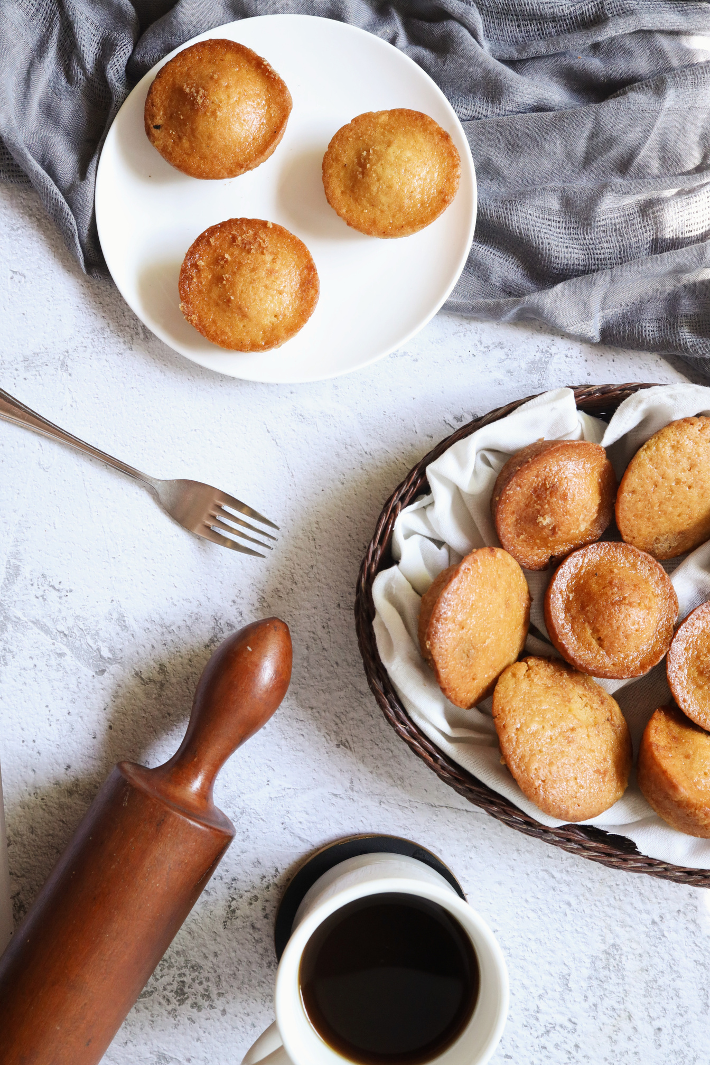


For the kingdom of God is not a matter of what we eat or drink, but of living a life of goodness and peace and joy in the HOLY SPIRIT. If you serve Christ with this attitude, you will please GOD, and others will approve of you too. So then, let us aim for harmony in the Church and try to build each other up.
ROMANS 14:17-19

Slide 6



Thank you for listening!
SHALOM !

